Slide 1
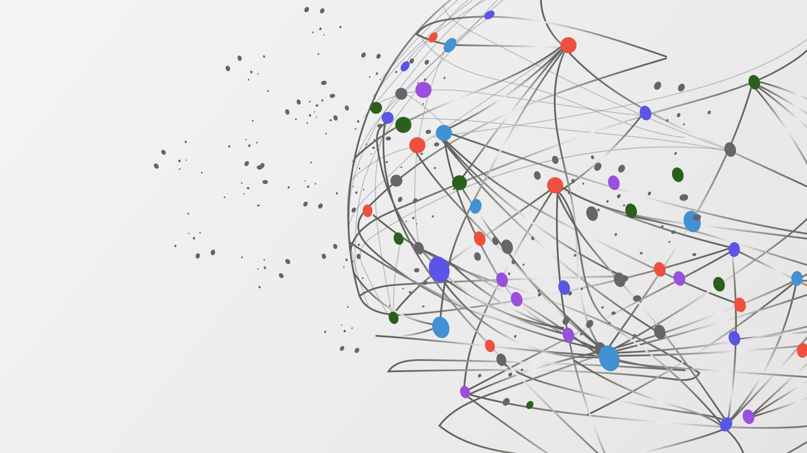
ABSTRACTIVE TEXT SUMMARIZATION
PATRICK NANYS, MÁTÉ JAKAB

Slide 2
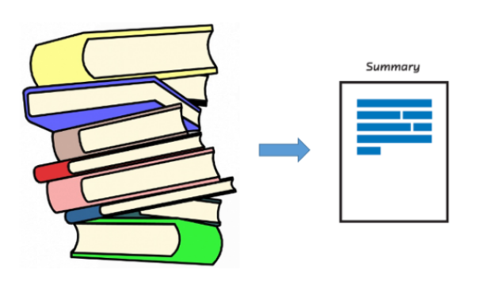
WHY IS IT AN IMPORTANT TOPIC?
Big amount of data (e.g. text data)
Gathering < analyzing
Summarization reduces reading time
Summarization of reviews
Advertise benefits (pros)
Make improvements (cons)

Slide 3
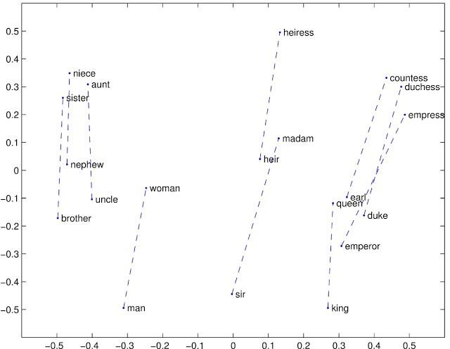
RELATED WORK
Extractive / abstractive summarization
Supervised / unsupervised learning
BERT (Google)
GloVe (Stanford)
GloVe example

Slide 4
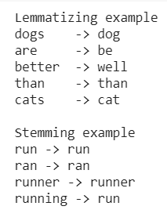
SOLUTION – PREPROCESSING
Database: Amazon reviews with summarizations
Take out stopwords (e.g: a, an, the)
Shorten remaining words
Lemmatizing
Stemming
Tokenization
Padding

Slide 5
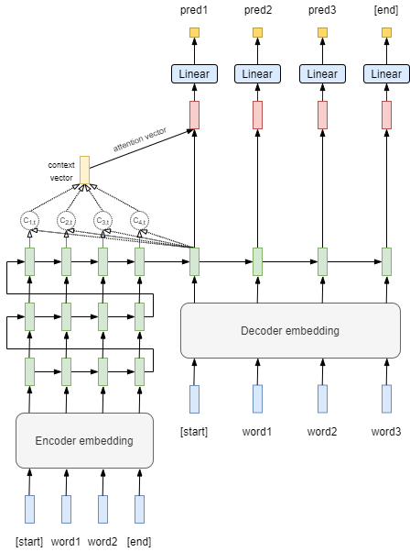
TRAINING - BASE
Sequence to sequence model
Separate encoder and decoder embeddings
LSTMs
Attention
Linear layers at the end for word classification

Slide 6

TRAINING - BERT
Different tokenizer
Only used BERT as part of the encoder

Slide 7

TRAINING - GLOVE
Tried different embedding setups
Played around with the start and end tokens

Slide 8
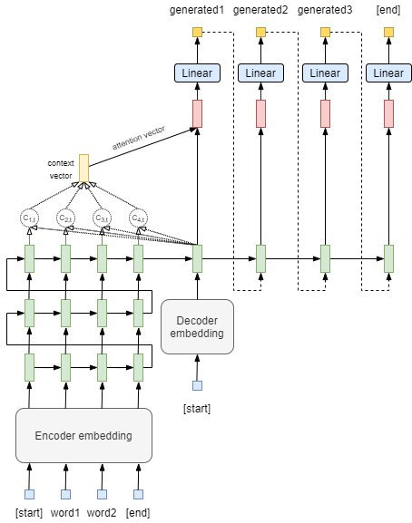
GENERATION
Input as one
Feeding predictions back in one by one
We continue until the model predicts an end token

Slide 9
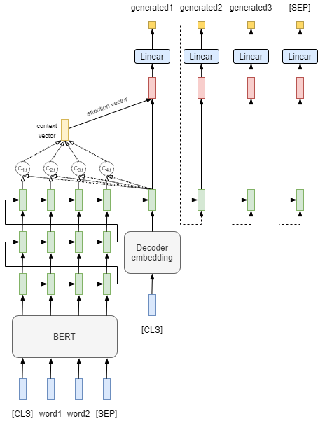


Slide 10
EVALUATION
Abstractive text summarization is hard to evaluate
Problems with calculating metrics (Rouge, Bleu)
Rouge score gave no good results

Slide 11
Original title | only LSTM | BERT | GLOVE
wonderful tasty taffy | great taste | great taste and good for you | great taste
my cats love this diet food better than their regular food | great food | good product | great food but not as good as the cats
my cats are not fans of the new food | good for cats | good for cats | great food, but not as good as the cats
cough medicine | good but not as good as the bit own | great taste | great product
not as advertised | not as good as the product | not what i expected | not as good as the money

Slide 12
SUMMARY
We learned a lot about working with text and complex neural network models
Our models were quite resource hungry
No time for parameter optimization
Had to run the models with less data which resulted in worse accuracy
Instead of optimizing parameters we tried building different models
Improve with: Bi-LSTMs, Teacher force ratio

